Slide 1
Báo cáo bài tập lớn
Đề tài :Introduction To Sql Tunning
Giảng viên hướng dẫn : TS.Trần Việt Trung
Sinh viên thực hiện :
Phùng Văn Dũng:20101292
Lê Đại Hoàn : 20091125
Phạm Quốc Khánh: 20101714
Lê Công Hưng: 20101667

Slide 2
Phân chia công việc
Phùng Văn Dũng: Tổng hợp báo cáo ,viết slide ,tìm hiểu về Reasons for Inefficient SQL Performance, Inefficient SQL,Performance Monitoring Solutions
Lê Đại Hoàn: Tìm hiểu về SQL Tuning Tasks, Scalability with Application Design,Implementation, and Configuration, Common Mistakes on Customer Systems, Proactive Tuning Methodology, Simplicity in Application Design,
Lê Công Hưng: Tìm hiểu về Table Design, Index Design, Using Views, SQL Execution Efficiency
Phạm Quốc Khánh: Tìm hiểu về Writing SQL to Share Cursors, Performance Checklist, Development Environments

Slide 3
Nội dung trình bày
Reasons for Inefficient SQL Performance
Performance Monitoring Solutions
SQL Tuning Tasks
CPU and Wait Time Tuning Dimensions
Scalability with Application Design, Implementation, and Configuration
Common Mistakes on Customer Systems, Proactive Tuning Methodology, Simplicity in Application Design, Data Modeling,Table Design, Index Design, UsingViews
SQL Excution Efficiency, Writing SQL to Share Cursors

Slide 4
Reasons for Inefficient SQL Performance
Stale or missing optimizer statistics
Missing access structures
Suboptimal execution plan selection
Poorly constructed SQL

Slide 5
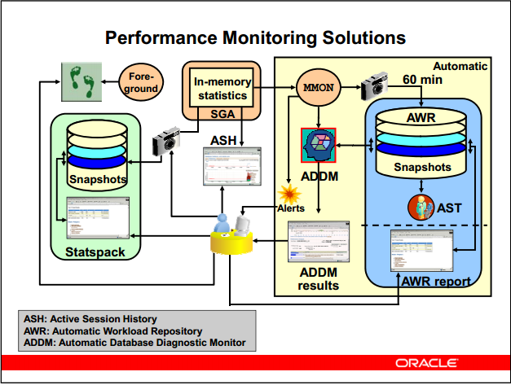
Performance Monitoring Solutions

Slide 6
Performance Monitoring Solutions
Performance Monitoring Solutions: It collects, processes, and maintains performance statistics for problem detection and self-tuning purposes
Active Session History (ASH):It provides sampled session activity in the instance. Active sessions are sampled every second and are stored in a circular buffer in SGA.
Automatic Workload Repository (AWR):It collects, processes, and maintains performance statistics for problem detection and self-tuning purposes. This data is both in memory and stored in the database. The gathered data can be displayed in both reports and views.

Slide 7
Performance Monitoring Solutions
Snapshots: Snapshots are sets of historical data for specific time periods that are used for performance comparisons by ADDM. AWR compares the difference between snapshots to determine which SQL statements to capture based on the effect on the system load. This reduces the number of SQL statements that must be captured over time.
Automatic Database Diagnostic Monitor (ADDM) :It has two categories are proactive monitoring , Reactive monitoring

Slide 8
SQL Tuning Tasks
Identifying high-load SQL
Gathering statistics
Generating system statistics
Rebuilding existing indexes
Maintaining execution plans
Creating new index strategies

Slide 9
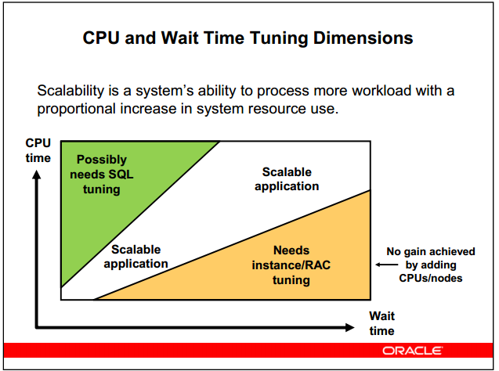
CPU and Wait Time Tuning Dimensions

Slide 10
Scalability with Application Design, Implementation, and Configuration
Applications have a significant impact on scalability
Poor schema design can cause expensive SQL that does not scale.
Poor transaction design can cause locking and serialization problems
Poor connection management can cause unsatisfactory response times

Slide 11
Common Mistakes on Customer Systems
Bad connection management
Bad use of cursors and the shared pool
Excess of resources consuming SQL statements
Use of nonstandard initialization parameters
Poor database disk configuration
Redo log setup problems
Excessive serialization
Inappropriate full table scans
Large number of recursive SQL statements related to space management or parsing activity
Deployment and migration errors

Slide 12
Proactive Tuning Methodology
Simple design
Data modeling
Tables and indexes
Using views
Writing efficient SQL
Cursor sharing
Using bind variables

Slide 13
Simplicity in Application Design
Simple tables
Well-written SQL
Indexing only as required
Retrieving only required information

Slide 14
Data Modeling
Accurately represent business practices
Focus on the most frequent and important business transactions
Use modeling tools

Slide 15
Table Design
Compromise between flexibility and performance
Use Oracle performance and management features: + Default values + Constraints
Focus on business-critical tables

Slide 16
Index Design
Create indexes on the following
+ Primary key (can be automatically created)
+ Unique key (can be automatically created)
+ Foreign keys (good candidates)
Index data that is frequently queried (select list).
Use SQL as a guide to index design.

Slide 17
Using Views
Simplifies application design
Is transparent to the developer
Can cause suboptimal execution plans

Slide 18
SQL Execution Efficiency
Good database connectivity
Minimizing parsing
Share cursors
Using bind variables

Slide 19
Writing SQL to Share Cursors
Create generic code using the following:
+ Stored procedures and packages
+ Database triggers
+ Any other library routines and procedures
Write to format standards (improves readability):
+ Case
+ White space
+ Comments
+ Object references
+ Bind variables

Slide 20
Performance Checklist
Set initialization parameters and storage options.
Verify resource usage of SQL statements.
Validate connections by middleware.
Verify cursor sharing.
Validate migration of all required objects.
Verify validity and availability of optimizer statistics

Slide 21
Cảm ơn thầy cô và các bạn đã lắng nghe

